Slide 1
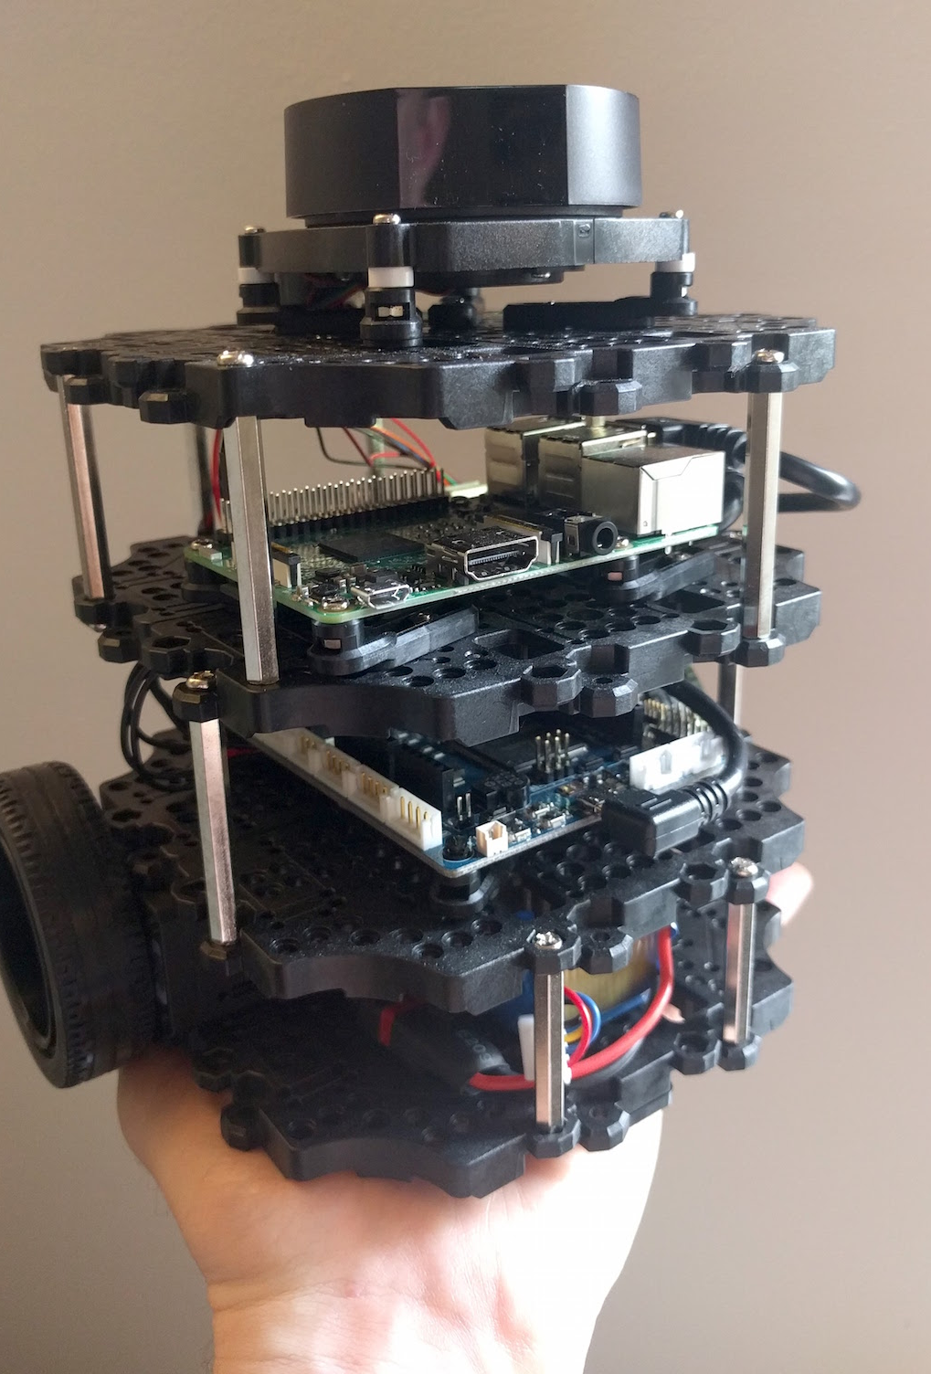
Presentation II on Unicycle and Differential Drive WMR EE 555 – Automation Lab
By- Meesala Ganesh
Narendra Sona
Santanu Barat
UNDER THE GUIDANCE OF Dr. Parijat Bhowmick

Slide 2
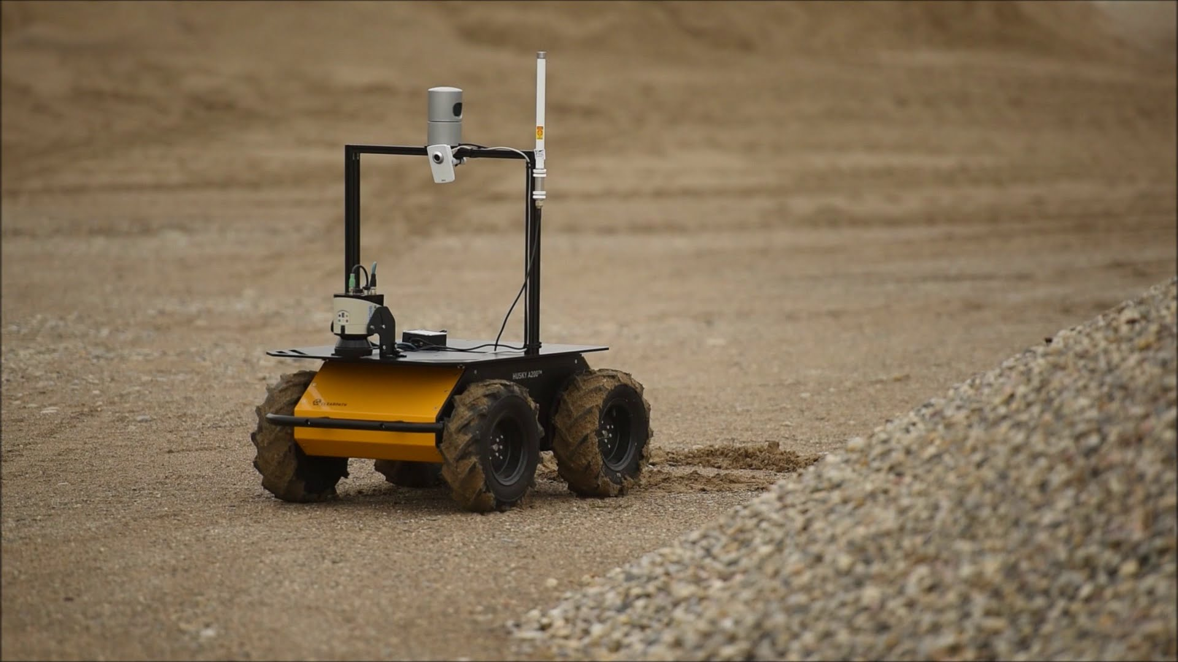
INTRODUCTION
Robots
Machines programmable by a computer
capable of carrying out complex series of actions
Mobile Robots
Locomotion Property
Mobile Robot. Source: Katte 2018.

Slide 3
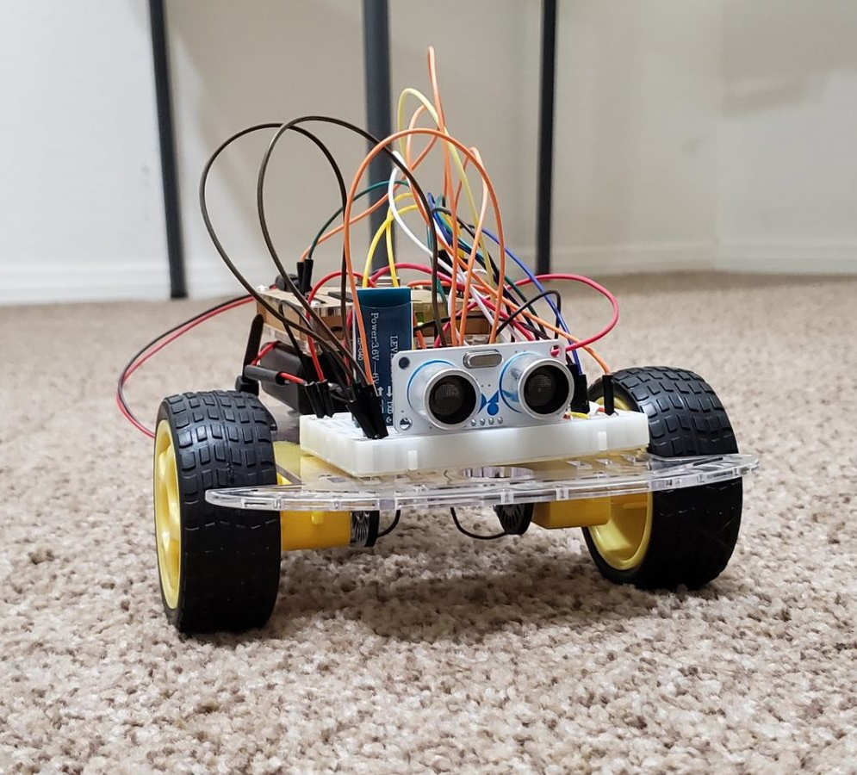
WHEELED MOBILE ROBOT
Features :
Locomotion
Consume less energy and move faster
Less stability problems
Types:
Unicycle
Differential drive WMR
Tricycle WMR
Car-like WMR
Source: www.automaticaddison.com

Slide 4
Turtlebot Specifications
Maximum linear velocity – 0.22m/sec
Maximum rotational velocity- 2.84 rad/sec
Weight- 1 kg
SBC(Single Board Computer)- Raspberry pi
A single-board computer (SBC) is a complete computer built on a single circuit board, with microprocessor(s), memory, input/output (I/O) and other features required of a functional computer.
MCU-32-bit ARM Cortex®-M7
The arm cortex-M7 processor is the highest performing processor in cortex –M family that enables the design of sophisticated MCUs.

Slide 5
Actuator-XL430-W250 (servo)
It is a cored motor with control modes of position and velocity.
DYNAMIXEL is an intelligent robot-exclusive actuator with a fully integrated DC motor + reduction gearbox + controller + pilot + network in a DC servo module.
LDS(Laser Distance Sensor)
360 Laser Distance Sensor LDS-01 is a 2D laser scanner capable of sensing 360 degrees that collects a set of data around the robot to use for SLAM (Simultaneous Localization and Mapping) and Navigation.
Battery-Lithium polymer 11.1V 1800mAh / 19.98Wh 5C
Power Adaptor
Input: 100-240V, AC 50/60Hz, 1.5A @max
Output: 12V DC, 5A
Power Connectors
Status LED
Buttons and Switches

Slide 6
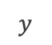
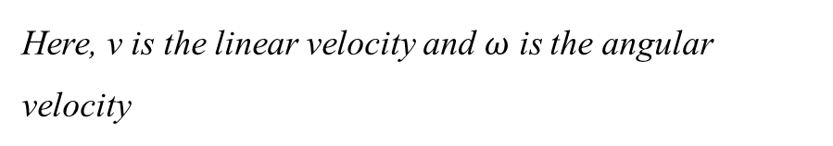
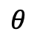
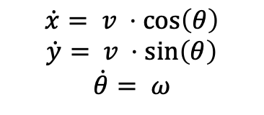

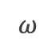
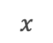
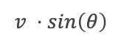
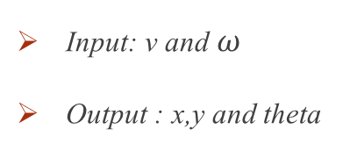
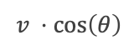
UNICYCLE WMR:
Unicycle is a conventional wheel rolling on a horizontal plane, while keeping its body vertical
Kinematics are as follows -
Y
$$v ⋅sin\left(θ\right)$$
$$v$$
$$θ$$
$$\dot{x}= v ⋅cos\left(θ\right)$$
$$\dot{y}= v ⋅sin\left(θ\right)$$
$$\dot{θ}= ω$$
$y$
$$v ⋅cos\left(θ\right)$$
$$ω$$
Here, v is the linear velocity and $ω$ is the angular
velocity
0
$$x$$
X
Input: v and $ω$
Output : x,y and theta
Fig.1 : Kinematic Model of Unicycle

Slide 7
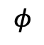
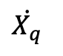
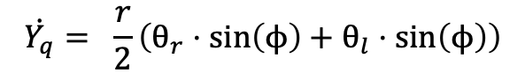
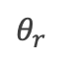
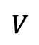
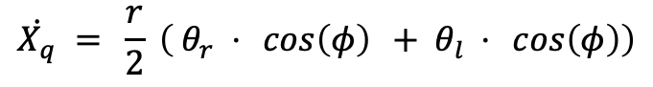
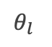

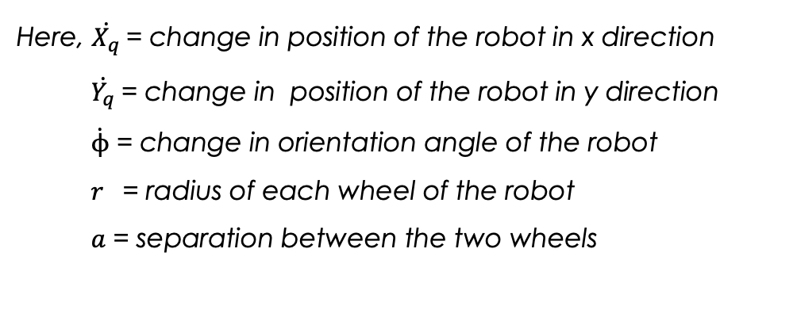
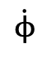
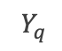
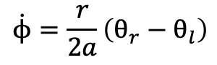
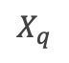
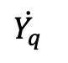
Differential Drive WMR :
A wheeled mobile robot whose movement is based on two separately drive wheels placed on either side of the robot body.
Kinematics are as follows -
Y
$$\dot{Y_{q}}$$
$$V$$
$$θ_{l}$$
q
$$\dot{X_{q}} = \frac{r}{2} \left( θ_{r} ⋅ \cos\left(φ\right) + θ_{l} ⋅ \cos\left(φ\right)\right)$$
$Y_{q}$
$$\dot{X_{q}}$$
$$\dot{ϕ}$$
$$\dot{Y_{q}}= \frac{r}{2}\left(θ_{r}⋅\sin\left(ϕ\right)+θ_{l}⋅\sin\left(ϕ\right)\right)$$
$$θ_{r}$$
$$\dot{ϕ}=\frac{r}{2a}\left(θ_{r}−θ_{l}\right)$$
$$φ$$
Here, $\dot{X_{q}}$= change in position of the robot in x direction
$\dot{Y_{q}}$= change in position of the robot in y direction
$\dot{ϕ}$ = change in orientation angle of the robot
$r$ = radius of each wheel of the robot
$a$ = separation between the two wheels
$$X_{q}$$
0
X
Fig.2 : Kinematic Model of Differential Drive WMR

Slide 8

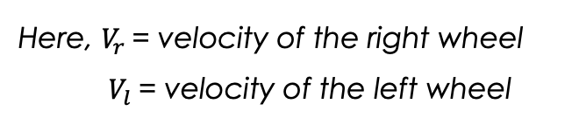
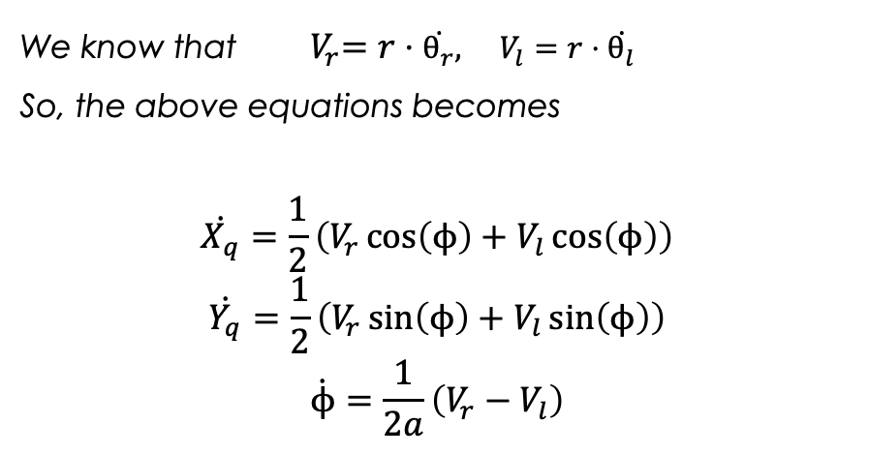
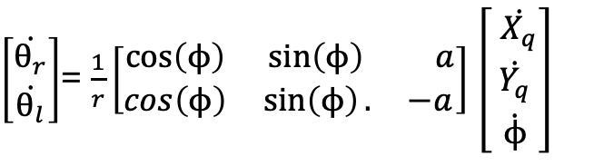
We know that ${ V}_{r}=r⋅\dot{θ_{r}}, V_{l}=r⋅\dot{θ_{l}}$
So, the above equations becomes
$$\dot{X_{q}}=\frac{1}{2}\left(V_{r}\cos\left(ϕ\right)+V_{l}\cos\left(ϕ\right)\right)$$
$$\dot{Y_{q}}=\frac{1}{2}\left(V_{r}\sin\left(ϕ\right)+V_{l}\sin\left(ϕ\right)\right)$$
$$\dot{ϕ}=\frac{1}{2a}\left(V_{r}−V_{l}\right)$$
Helpful in writing these equations
Here, $V_{r}$= velocity of the right wheel
$V_{l}$= velocity of the left wheel
In matrix form ,
$\left[\begin{aligned}\dot{θ_{r}} \\ \dot{θ_{l}}\end{aligned}\right]$= $\frac{1}{r}\left[\begin{matrix}\cos\left(ϕ\right) & \sin\left(ϕ\right){a} \\ cos\left(ϕ\right) & \sin\left(ϕ\right).{−a}\end{matrix}\right]$ $\left[\begin{aligned} \dot{X_{q}} \\ \dot{\begin{aligned}Y_{q} \\ \dot{ϕ}\end{aligned}}\end{aligned}\right]$
TRANSFORMATION MATRIX

Slide 9
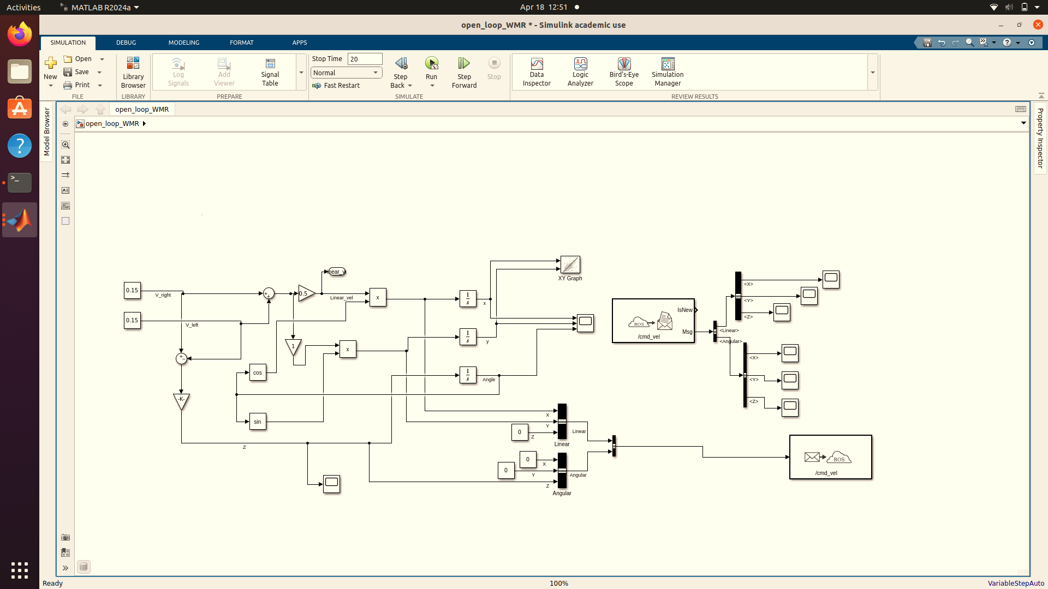
SIMULINK MODEL of UNICYCLE :

Slide 10
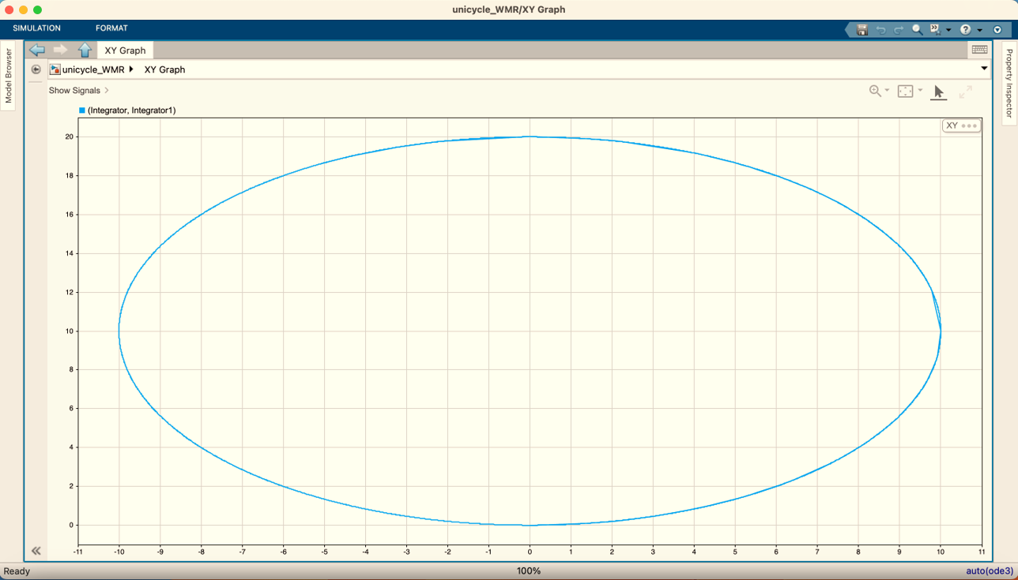
Result : X-Y Position using XY Graph Block of Simulink Model

Slide 11
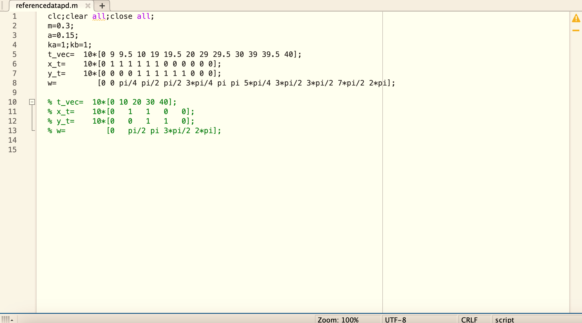
SIMULINK MODEL of DIFFERENTIAL DRIVE WMR :
PID Controller

Slide 12
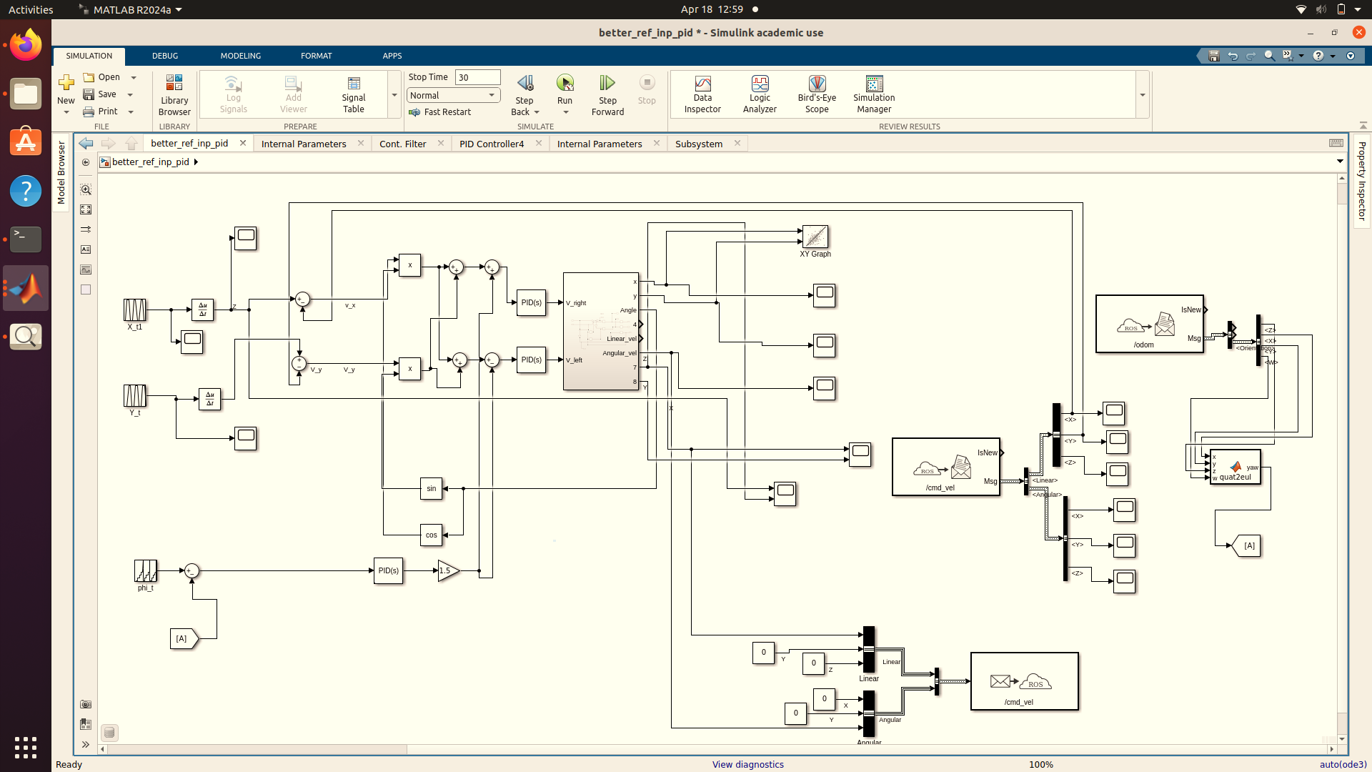

Slide 13
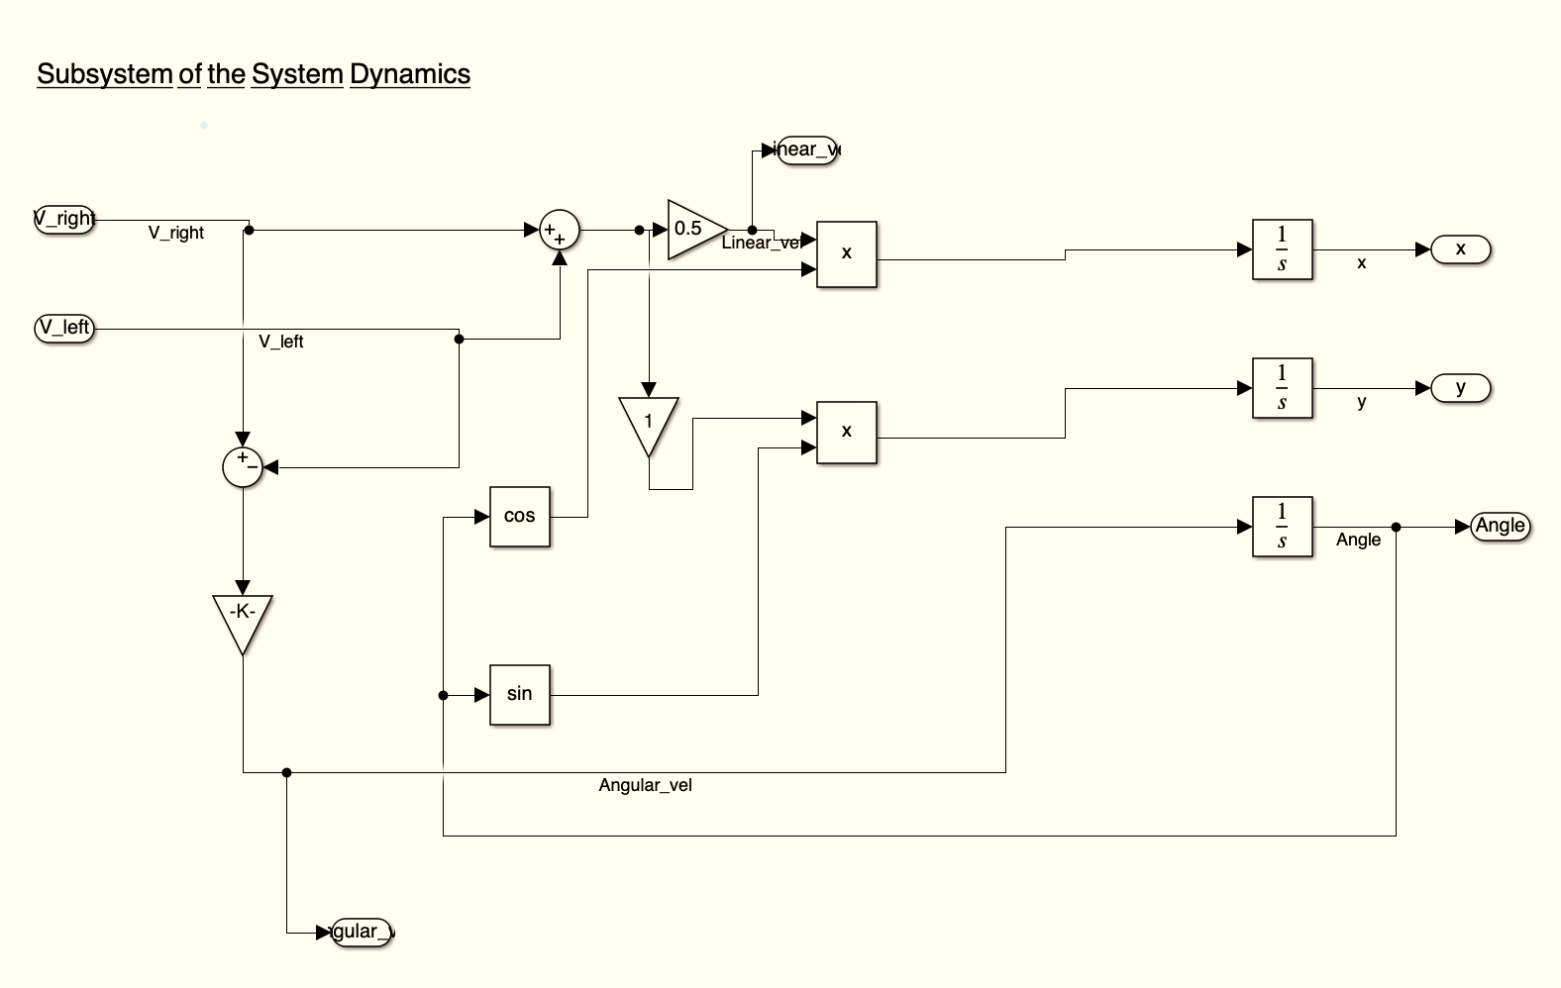

Slide 14
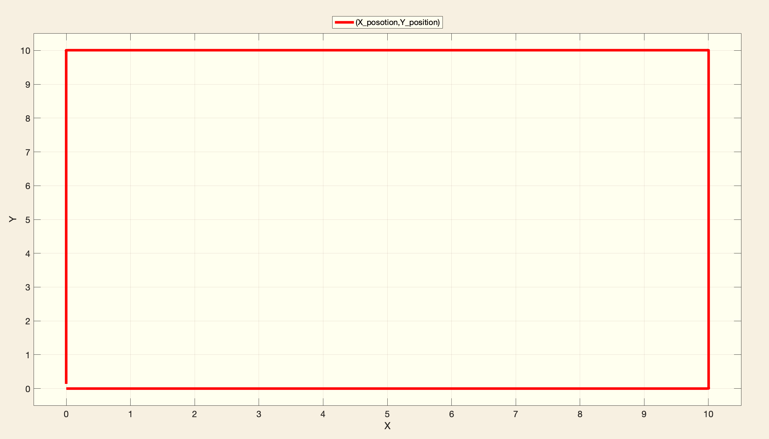
Result and Analysis: Trajectory tracking of final PID Controller

Slide 15
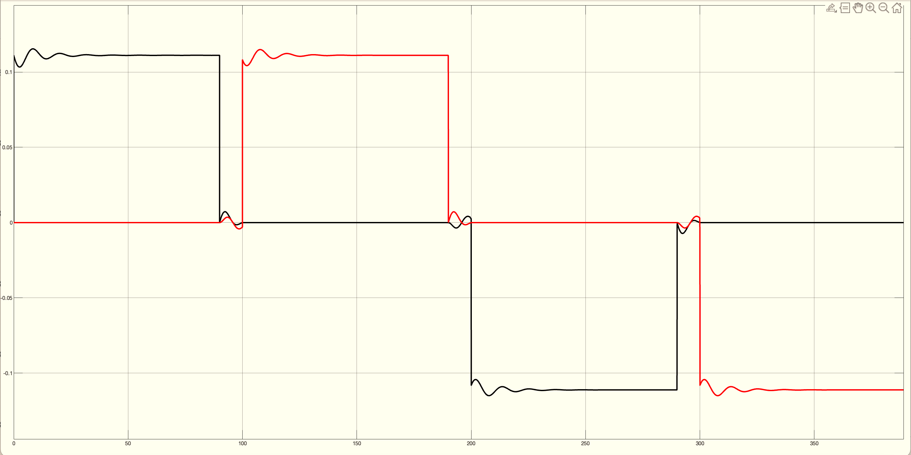
Linear velocity along x and y directions

Slide 16
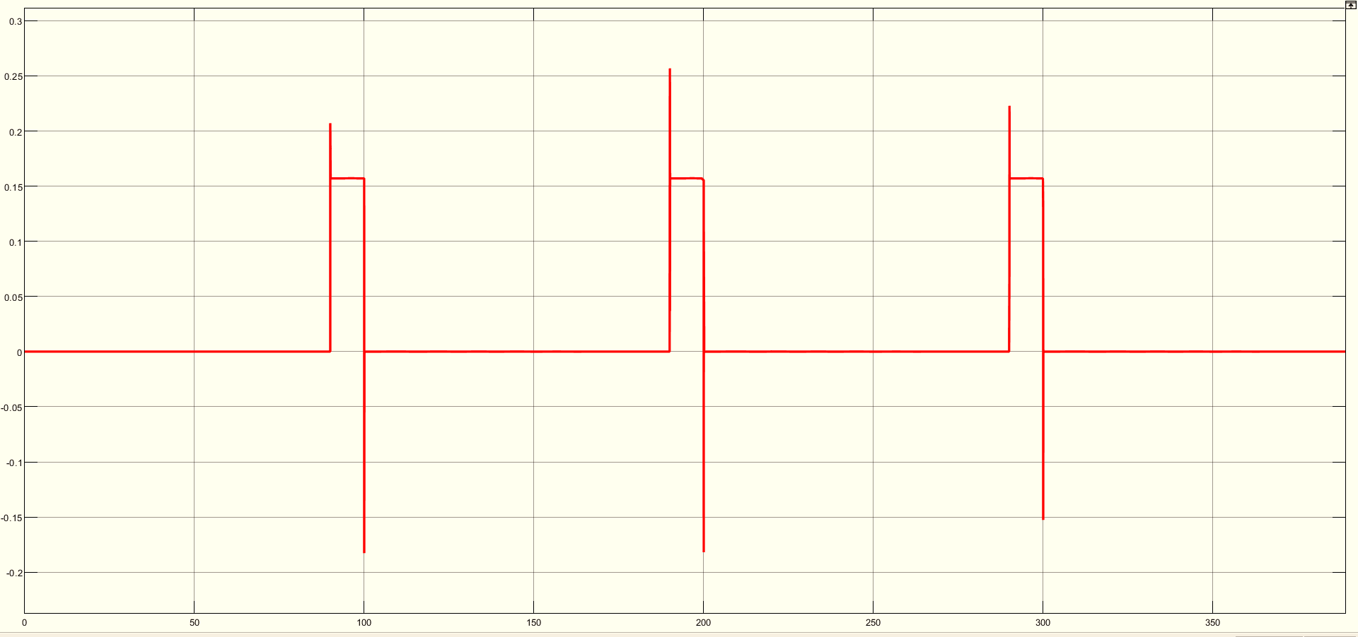
Angular velocity

Slide 17
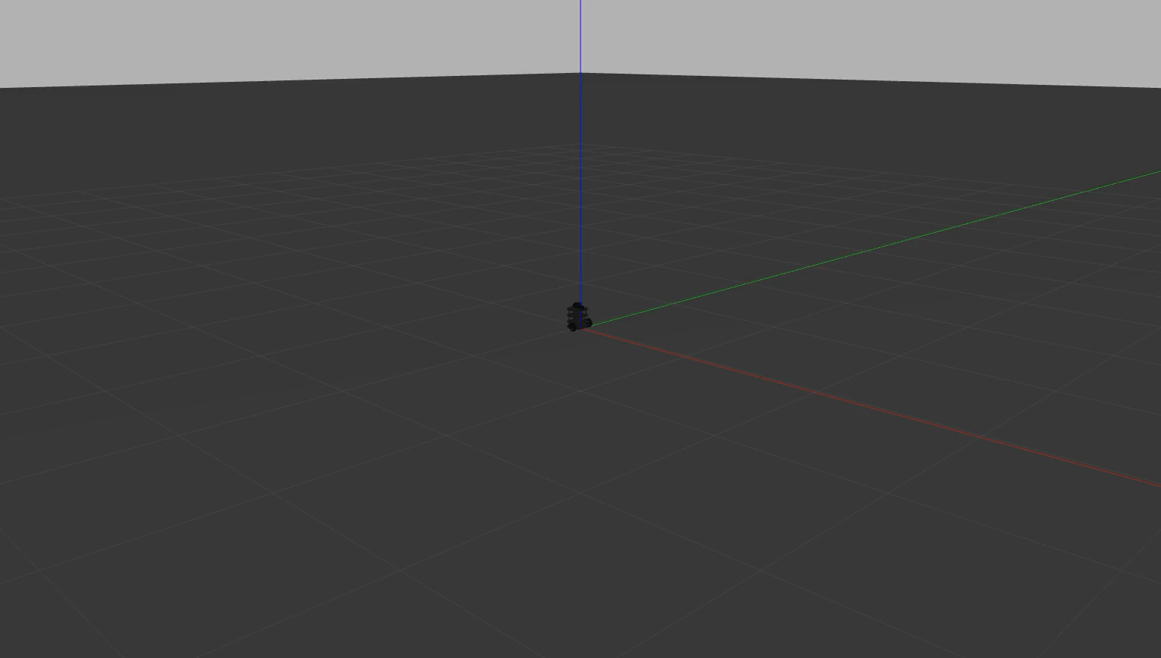
Experimental Validation :
Open Loop:
Gazebo simulation:

Slide 18
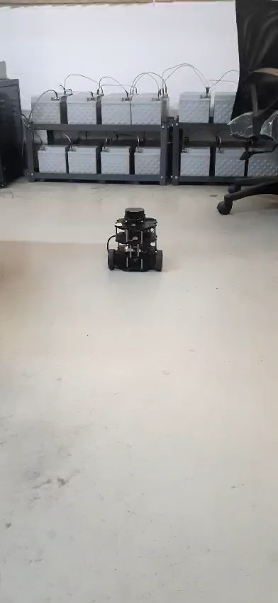
Turtlebot implementation:

Slide 19
Conclusion:
In this lab we learned and implemented both open loop and closed loop simulink models of unicycle and differential drive 2- wheeled mobile robots.
Designed PID controller for achieving a rectangular trajectory tracking and verified the open loop simulation results with Gazebo simulation and experimental validation using turtlebot.
Future Works:
This work can be extended for complex trajectory tracking and obstacle avoidance problems.
Further, it can be used for controlling of multiagent mobile robots.

Slide 20

Thank you

